Slide 1
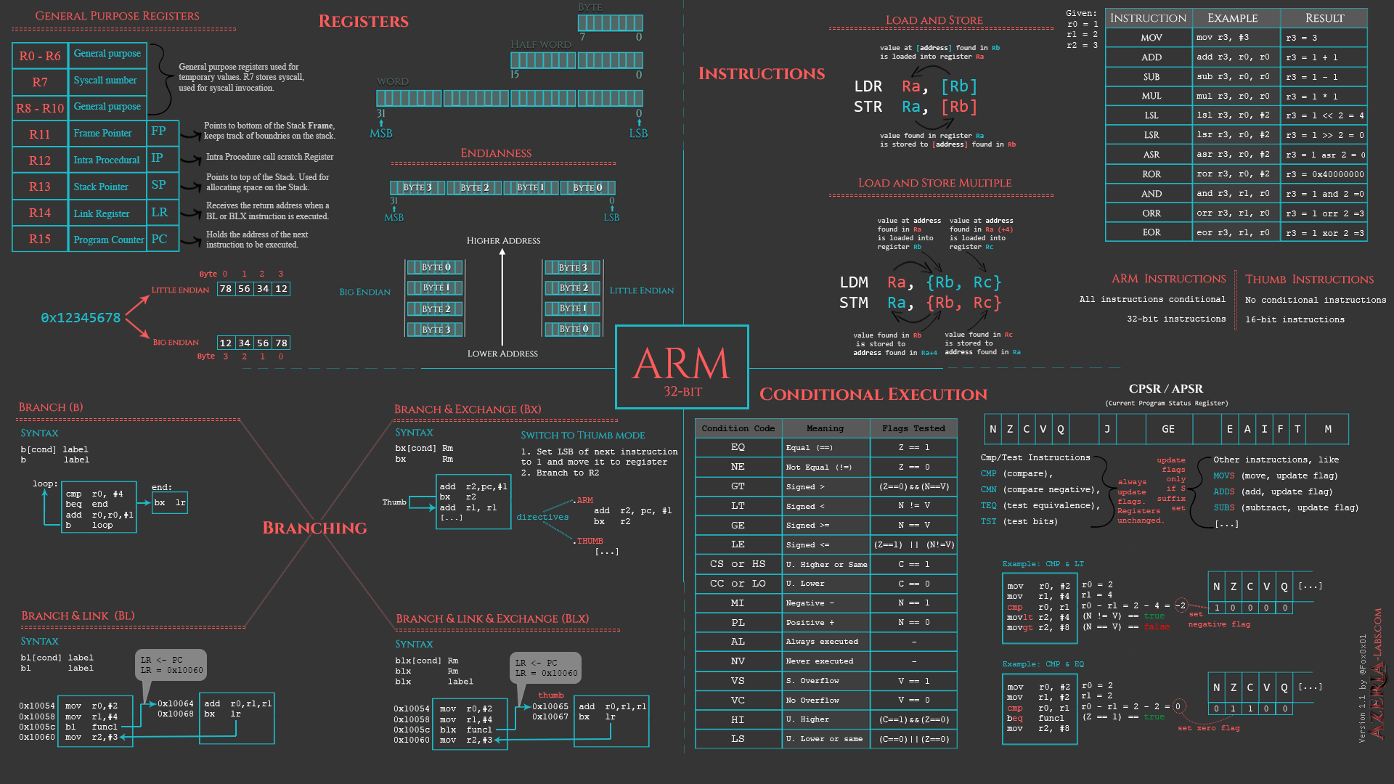
FLAGS
8086 Assembly
CSE 315 January 2022
Md. Tareq Mahmood
Department of CSE, BUET

Slide 2
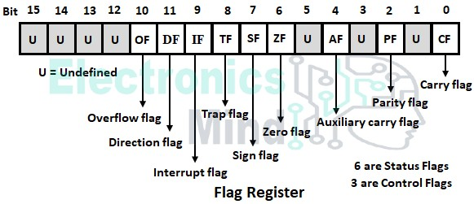
FLAGS Register

Slide 3
The FLAGS Register flags
Flag | Intel Mnemonic
Overflow | OF
Sign | SF
Zero | ZF
Auxiliary Carry | AF
Parity | PF
Carry | CF

Slide 4
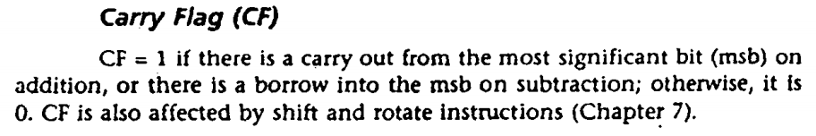
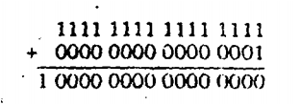
Carry Overflow (Unsigned overflow)

Slide 5


Signed Overflow

Slide 6
CF vs OF
OF = 1 for signed overflow, CF =1 for unsigned overflow.
CF = 1, if there is a carry out of the MSB on addition. However, CF is not affected by INC or DEC.
OF = 1, if we add two numbers of the same sign and the result is of different sign. If we add two numbers of the different sign, there is no way of overflow.
Detail Explanation: https://stackoverflow.com/a/25926578

Slide 7
ZF, SF and PF
ZF = 1 if the result is zero.
SF = 1, if the msb of result is 1.
PF = 1, if the low byte of the result has an even number of 1s (even parity).

Slide 8
References
Chapter 5

